Slide 1

Team 72 # | RP 7001 | Asset Management System
Date: 22-03-2025
Team Members
P. MAHINDRA – 23BD1A661D​
C.V.S. GANESH – 23BD1A609​
T. HASHWITH – 23BD1A660J​
SHARATH – 24BD5A0538​
JAYAKAR – 23BD1A665H
Mentors
1.Ms.Arthi
2.Mr.Seshu

Slide 2
INTRODUCTION
SCOPE : ​
The primary purpose of the Asset Management
System (AMS) is to facilitate the reporting of asset
issues within an organization. It provides a
streamlined platform for users to report, track, and
manage asset-related problems. Additionally, the
system ensures timely resolution and proper
maintenance of assets like laptops, printers, and
scanners.​
​
TECHNOLOGIES :​
It is a project done by using web-applications
​
Front end : ​
react.js / react native​
Backend : ​
Express.js, Node.js, JWT(Json web tokens)
Database:
MongoDB

Slide 3
ABSTRACT :​
The Purpose of this document is to define the system requirements for the Asset Management System
This system will allow organizations to efficiently track, manage, and maintain assets, such as laptops, printers, scanners, projectors, mouse, keyboard, headset etc. The AMS will ensure that assets are properly tracked, scheduled for maintenance, and disposed of when no longer needed.
Requests are aggregated, centrally processed, assets are distributed through the common store, with asset tagging and tracking to final issuance. Reports are generated for various purposes, like total assets, or for a specific department in AMC or end of service assets etc.​
​
For each item a QR code is attached and stored in the DB as a line item. If the item is not working then scan the QR code to report the problem. This scanning and reporting is done via a mobile app.

Slide 4
END USERS AND THEIR REQUIREMENTS :
1. Employees / Users​
Role: Regular employees using company assets​(e.g., laptops, printers, scanners).​
Requirements: ​
Report issues using a mobile or web app.​
Scan QR codes to fetch asset details and raise complaints easily.​
Track the status of reported issues in real-time.​
Receive notifications on issue updates and resolutions.​
2. Admins / Asset Managers​
Role: IT admins or asset managers overseeing asset lifecycle and issue management.​
Requirements: ​
User Management: Create and manage users with role-based access.​
Asset Management: Track, add, update, or remove assets.​
Issue Monitoring: View and manage reported issues.​
Generate Reports: Analyze data on issue frequency, resolution time, and asset performance.​
Schedule Maintenance: Plan and assign preventive or corrective maintenance tasks.​
Audit Logs: Access system logs for compliance and monitoring.

Slide 5
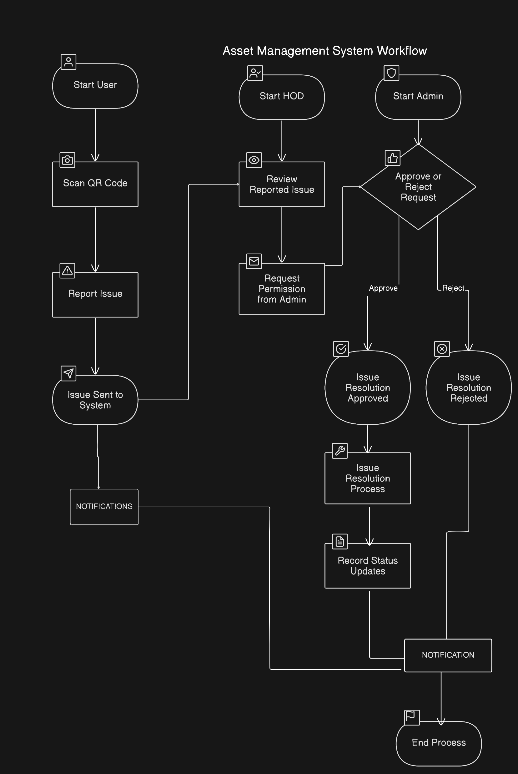
WORK FLOW →

Slide 6
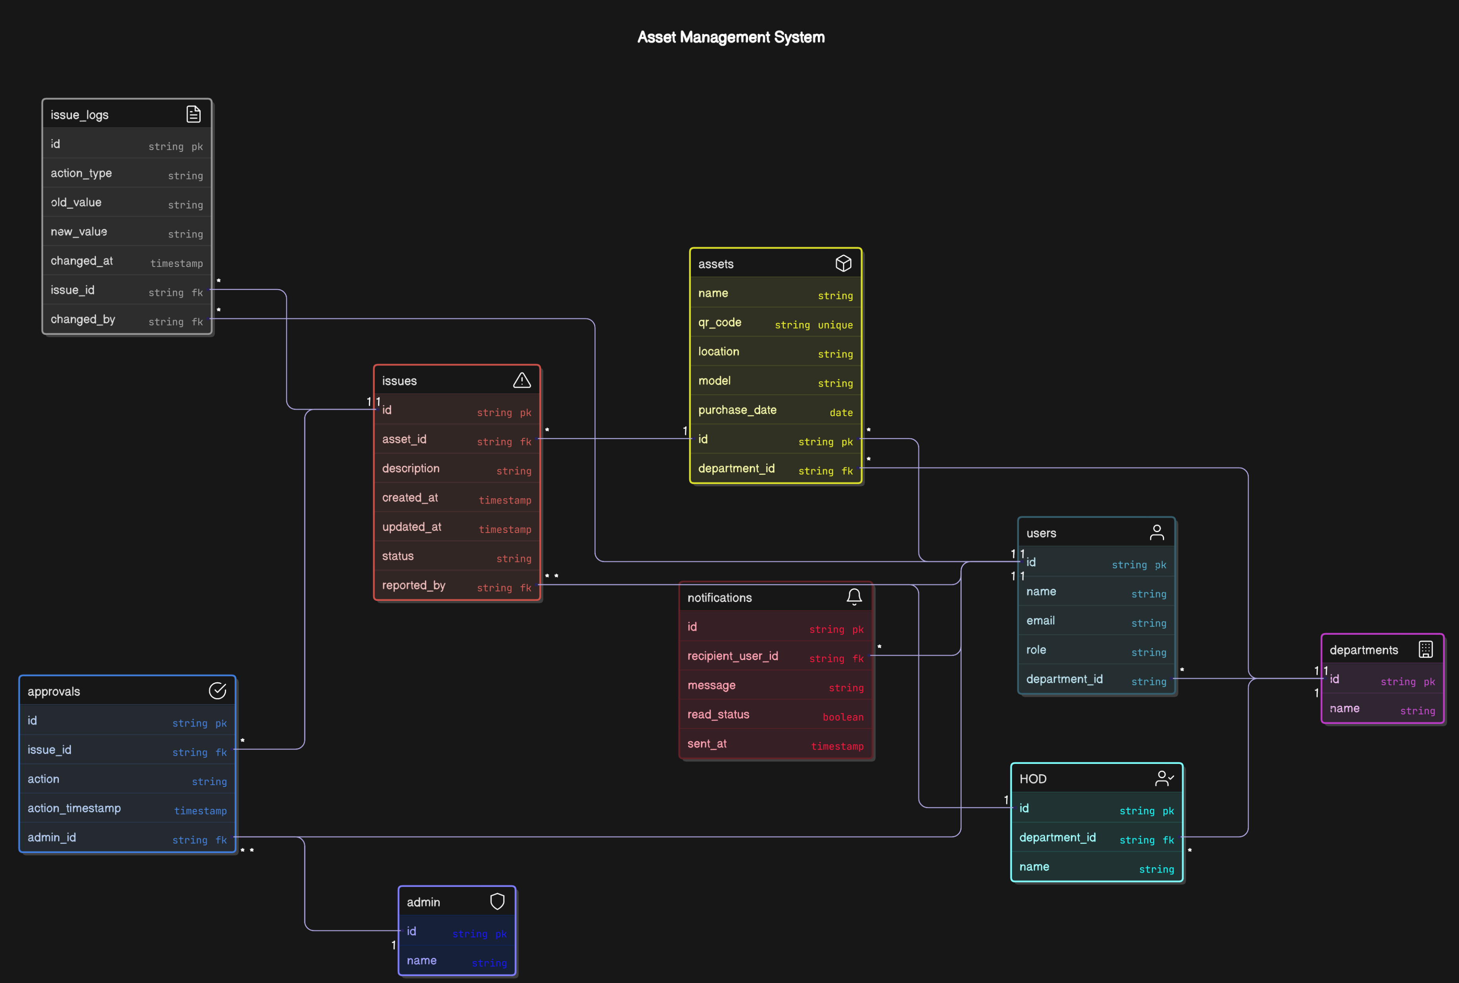
DATA BASE DESIGN

Slide 7
Issue Reporting and Resolution: Provide users with an easy way to report asset issues and monitor the resolution process.
EXPECTED OUTCOME
Asset Tracking and Management: Efficiently track, manage, and maintain assets using a centralized platform with QR code tagging.
Maintenance Scheduling: Ensure timely maintenance of assets by scheduling and tracking maintenance activities
Secure Authentication and Authorization: Implement JWT-based authentication for secure access, with role-based permissions.
Dashboard and Reporting: Offer insights through reports and dashboards for better decision-making
Issue Reporting and Resolution: Provide users with an easy way to report asset issues and monitor the resolution process.

Slide 8
Thank you!

